Slide 1
MySQL INTERNSHIP
Task 3 : Pharma Analysis

Slide 2
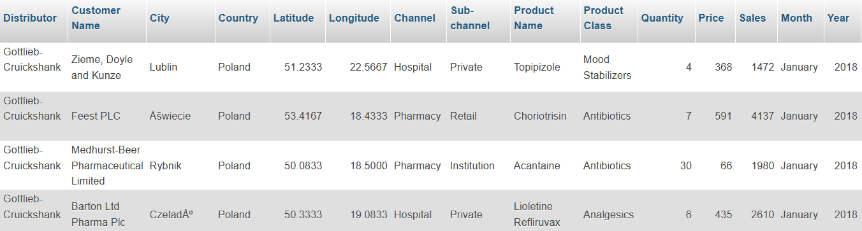
1. Retrieve all columns for all records in the dataset.
select * from pharma_data ;

Slide 3

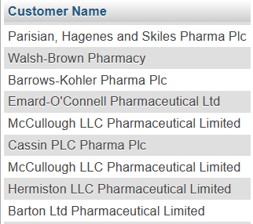
2. How many unique countries are represented in the dataset?
select count(distinct(country)) as count_country from pharma_data ;
3. Select the names of all the customers on the 'Retail' channel.
select `Customer Name` from pharma_data where `Sub-channel` = 'Retail';

Slide 4


4. Find the total quantity sold for the ' Antibiotics' product class.
select `Product class`,sum(Quantity) from pharma_data where `Product Class` = 'Antibiotics';
5. List all the distinct months present in the dataset.
select distinct(month) from pharma_data;

Slide 5
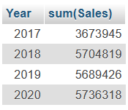

6. Calculate the total sales for each year.
select Year, sum(Sales) from pharma_data group by year;
7. Find the customer with the highest sales value.
select `Customer Name`,max(sales) from pharma_data;

Slide 6
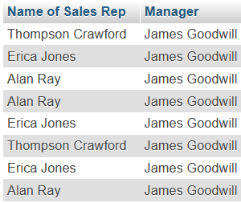
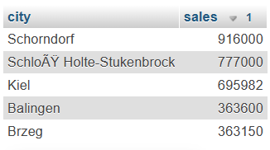
8. Get the names of all employees who are Sales Reps and are managed by 'James Goodwill’.
select `Name of Sales Rep`,Manager from pharma_data where manager = 'James Goodwill';
9. Retrieve the top 5 cities with the highest sales.
select city, sales from pharma_data order by sales desc limit 5;

Slide 7
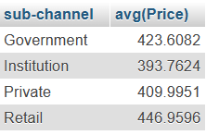
10. Calculate the average price of products in each sub-channel.
select `sub-channel`, avg(Price) from pharma_data group by `sub-channel`;
11. Join the 'Employees' table with the 'Sales' table to get the name of the Sales Rep and the
corresponding sales records.
(There is no sufficient records to retrieve answers for this query)

Slide 8
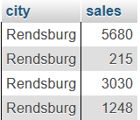
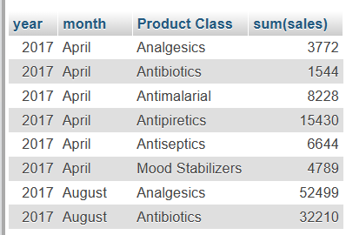
12. Retrieve all sales made by employees from ' Rendsburg ' in the year 2018.
select city, sales from pharma_data where year = 2018 and city = 'Rendsburg';
13. Calculate the total sales for each product class, for each month, and order the results by
year, month, and product class.
select year,month,`Product Class`,sum(sales) from pharma_data group by year,month,`Product Class`;

Slide 9
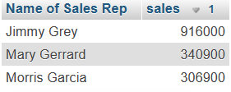
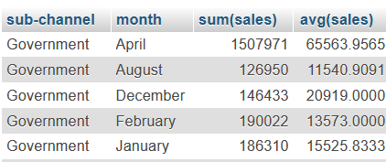
14. Find the top 3 sales reps with the highest sales in 2019.
select `Name of Sales Rep`,sales from pharma_data where year = 2019
order by sales limit 3;
15. Calculate the monthly total sales for each sub-channel, and then calculate the average
monthly sales for each sub-channel over the years.
select `sub-channel`, month,sum(sales),avg(sales) from pharma_data group by
`sub-channel`,month;

Slide 10
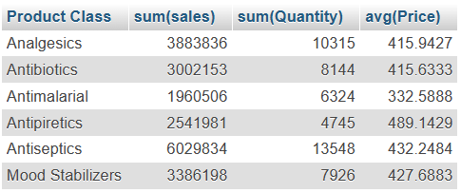
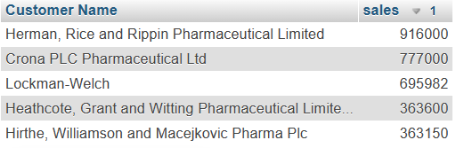
16. Create a summary report that includes the total sales, average price, and total quantity
sold for each product class.
select `Product Class`,sum(sales),sum(Quantity),avg(Price) from pharma_data
group by `Product Class`;
17. Find the top 5 customers with the highest sales for each year.
select `Customer Name`,sales from pharma_data order by sales desc limit 5;

Slide 11
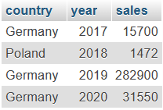
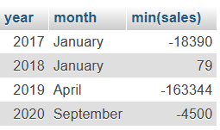
18. Calculate the year-over-year growth in sales for each country.
select country,year,sales from pharma_data group by year;
19. List the months with the lowest sales for each year
select year,month,min(sales) from pharma_data group by year;

Slide 12
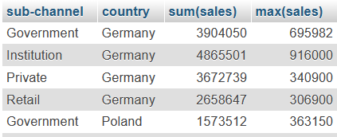
20. Calculate the total sales for each sub-channel in each country, and then find the country
with the highest total sales for each sub-channel.
select `sub-channel`,country,sum(sales),max(sales) from pharma_data
group by country,`sub-channel`;

Slide 13
Thank you

